Slide 1
a powerpoint for English class idk funny how we make things like powerpoints that we COULD get money for doing but we don’t because it is for school and therefore free. Schools get everything free.

Slide 2
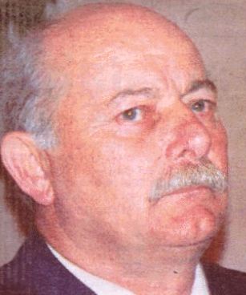
Gary Staples
Charge: Murder
Sentence:
Years Imprisoned: 2
Year Crime: 1969
Year Convicted: 1970
Year Cleared: 1972
Crime Location: Canada, Ontario
Result: Judicially Exonerated Released
Summary Of Case: "Gary Staples was convicted in 1970 of murdering a taxi cab driver in Hamilton, Ontario in 1969. Staples' conviction was based on the testimony of his ex-girlfriend who testified in exchange for leniency on robbery charges. She testified that Staples confessed the shooting to her. Staples described her as a "jilted girlfriend," and "She wanted to get even." Staples alibi is he was 35 miles from Hamilton at the time of the murder. After his conviction Staples appealed. His conviction was overturned and a new trial ordered. He ws acquitted after his second trial in 1972. In 2001 two law students from Osgoode Hall were going through the Hamilton police's file on the Staples case when they found a memo written by a police officer that had not been turned over to Staples' lawyer. The memo described two witnesses whose testimony would have corroborated his alibi of being 35 miles from Hamilton at the time the crime occurred. Staples was acquitted even without the concealed evidence. Staples filed a $6 million lawsuit in In 2001 against the Hamilton Police Department based on the concealed exculpatory evidence. In 2002 he was officially cleared of the murder when the Hamilton police sent him a written apology. Staples was also paid an undisclosed amount of compensation to settle the lawsuit.“
Conviction Caused By: "Perjurious testimony of an ex-girlfriend, and police misconduct of concealing exculpatory witness statements.“
Innocence Proved By: Staples' conviction was overturned and he was acquitted on appeal in 1972.
Compensation Awarded: Yes in 2002 for an undisclosed amount
Age when Imprisoned: 25
Age when released: 27
Sex: Male

